Slide 1
Technological Revolutions and Financial Capital
The Dynamics of Bubbles and the Golden Age
Chapters 11-13
Carlota Perez
Kseniia Pirnavskaia

Slide 2
OUTLINE
Turning Point
Synergy
Maturity
Innovations

Slide 3
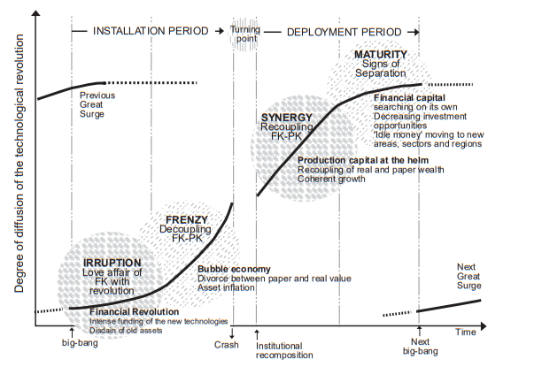

Slide 4
Turning Point
Fundamental Causes of the After-Frenzy Recession: structural unsustainability of bubbles or mania = big delusion. Galbraith: it is not the facilitating circumstances of the period but ‘their own superior insight and intuition’.
Why not indefinite? - real v paper wealth; existing demand v potential supply, socially excluded v those reaping the benefits of the bubble
Frenzies are the best and worst of times for different groups of people
Bubble collapse: NASDAQ in 2000 -> recession, weakening the economy -> affected dependent Asian and later European states
Lessons are short-lived, many of the new rules remain both in the law and as common sense
Opportunity for turning the tables in favor of production capital and more harmonious growth

Slide 5
The Long depression in 1930s
Why so long?
The outcome is very much determined by politics, ideologies, and relative power
The length of the recession/depression does not depend on economic factors only, not even on economic policies and measures narrowly understood.
No proper regulatory framework
After the recession sets in, whichever political groups have or seize the opportunity to represent the collective interests will shape the future

Slide 7
Synergy
Synergistic growth, an extension of markets, and increasing employment
Growth is rooted in real production, the relative values of money across the sectors stabilize and seem understandable to most people
Orderly and ordered behavior
Establishment of framework: regulations/institutions
Social innovations such as welfare system: income safety nets, health & education, provision of reliable national statistics to help business planning
Schumpeter: institutional innovation was usually the codification of already accepted practice
Instruments & tailored to emerging business practices: innovations in types of money, banking, services, and forms of credit or finance together with measures of public policy

Slide 8
Specifics
multiplication of country banks to help industrialists make local payments and move money to London (1st surge)
checks became means of payment in the Victorian Boom
vendor shares, debentures, and preference shares made capital markets flexible and adaptable
generalized limited liability - legislation facilitating the formation of giant corporations
widespread consumer and home-buying credit
Range of sectors that support growth and need financing:
the core industries of the paradigm
the whole of the old economy being modernized and rejuvenated
a group of new industry and service branches supplementary to the others and complete the fabric of the economy

Slide 10
Maturity
spectrum of opportunities for new investment becomes narrower
the product life cycles of later products – even of later technology systems – become shorter
investment in increasing productivity is less effective, new profit opportunities are harder to come by
mid-life crisis with growing social discontent and economic decline of the established production structure
Brings merger time again to amass market share in search of economies of scale to boost falling profits
Another surge is about to emerge

Slide 11
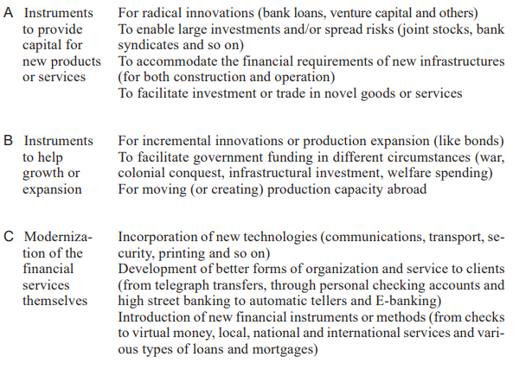
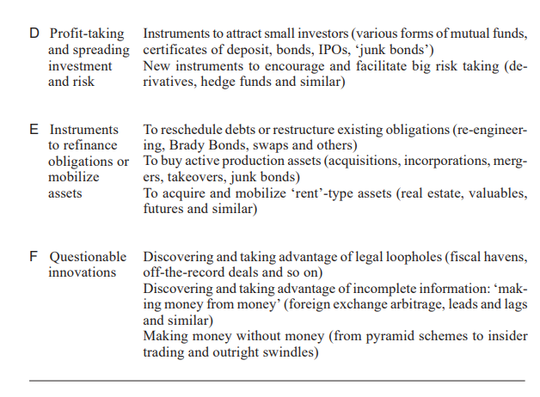
Financial innovations

Slide 12
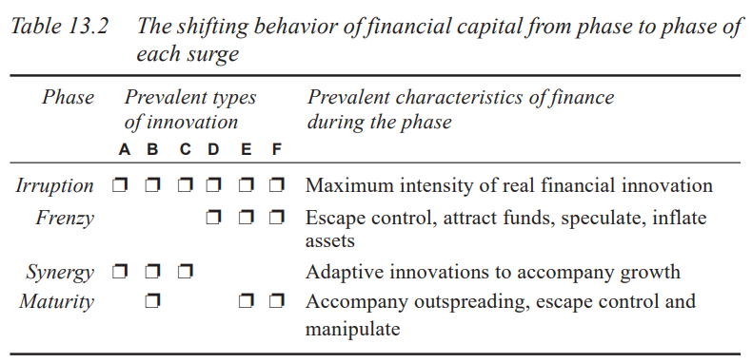

Slide 13
Foundation of financial innovation
need to be supported and regulated by adequate institutional innovations
welfare and unemployment insurance schemes
recognized labor unions
a massive tax system
legal compartmentalization of the various financial roles, from savings and loans to investment
policy tools will have to closely conform to the current technological revolution and its paradigm.

